Slide 1
Requirement VPS Cloud
Telkom IOT Center Andy Maulana Yusuf

Slide 2
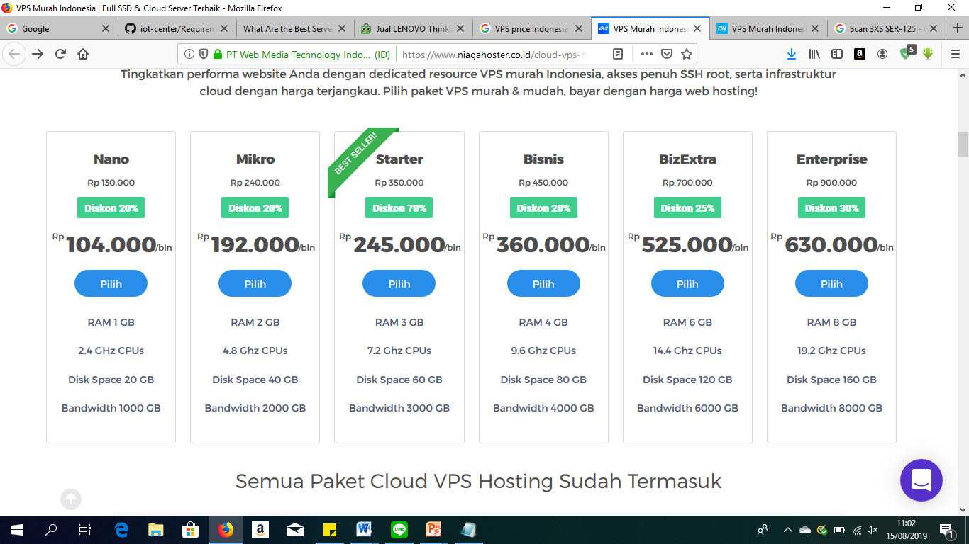
Small Business
4.8 Ghz CPUs
2GB
40GB
2 TB - Unlimited
IDR 192 – 400 / Month
- Niaga Hoster
- Domainesia

Slide 3
Medium Business
7.2 – 9.6 Ghz CPUs
3 - 4GB
60 – 80GB
4 TB - Unlimited
IDR 245 – 800 / Month
- Niaga Hoster
- Domainesia

Slide 4
High Business
14.4 – 19.2 Ghz CPUs
6 – 8GB
120 – 160GB
Unlimited
IDR 525 – 1.200 / Month
- Niaga Hoster
- Domainesia

